Slide 1
Lecture#12
Neural Networks-2
x₁
O1
x₂
x₃
O2

Slide 2
Backpropagation
Its name comes from “ a training method, which backpropagate the errors to update the previous weight layers.
It is a feedforward multilayer perceptron trained by the generalized delta rule, which use a gradient descent method to minimize the total squared error (SSE) of the output computed by the net.

Slide 3
Y₁
...
Y_{k}
...
Y_{m}
w₀₁
w_{0k}
w_{pk}
w_{0m}
w_{pm}
w₁₁
w_{p1}
w_{1k}
w_{jk}
w_{j1}
w_{1m}
w_{jm}
1
Z₁
Z_{j}
Z_{p}
v_{0p}
v₀₁
v_{n1}
v_{0j}
v_{nj}
v_{1p}
v_{np}
v₁₁
v_{i1}
v_{1j}
v_{ij}
v_{ip}
1
X₁
...
X_{i}
...
X_{n}
“ A backpropagation neural network with one hidden layer ”

Slide 4
Backpropagation algorithm
*See details in supplementary
Step0: Initialize weights
Step1: While stopping condition is FALSE (i.e SSE > 0.01)
    Step2: For each training record
  Feedforward
      Step3: Each input nodes & a bias broadcast signals
      Step4: Compute net_input at each hidden node and calculate the output of each hidden node
      Step5: Compute net_input at each output node and calculate the output of each output node
      Backpropagation of error
      Step6: Compute error at each output node and weight corrections
      Step7: Compute error at each hidden node and weight corrections
      Step8: Update weights and biases in both layers
    Step9: Test stopping condition

Slide 5
Ex1 Applying a BPNN to the XOR problem
x₂
X₁ | X₂ | O
1 | 0 | 1
0 | 1 | 1
0 | 0 | 0
1 | 1 | 0
1
XOR ~ Not linearly separable problem
1
x₁
X₁
v11
v21
z
W11
Y
X₂
v01
1
W01
1

Slide 6
Ex2 Applying a BPNN to a character recognition problem
0 | 0 | 1 | 1 | 0 | 0 | 0
0 | 0 | 0 | 1 | 0 | 0 | 0
0 | 0 | 0 | 1 | 0 | 0 | 0
0 | 0 | 1 | 0 | 1 | 0 | 0
0 | 0 | 1 | 0 | 1 | 0 | 0
0 | 1 | 1 | 1 | 1 | 1 | 0
0 | 1 | 0 | 0 | 0 | 1 | 0
0 | 1 | 0 | 0 | 0 | 1 | 0
1 | 1 | 1 | 0 | 1 | 1 | 1
0
0
1
1
0
0
0
X =
....

Slide 7
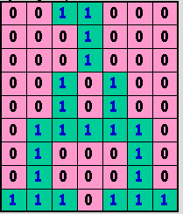
A
1
X₁
B
0
X₂
C
0
D
0
.....
E
0
1
J
0
X₆₃
K
0
1

Slide 8
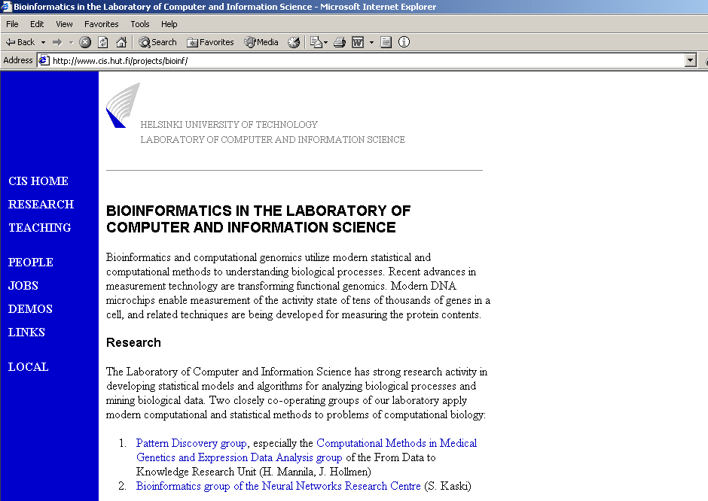
Ex3 Applying an ANN in bioinformatics problem
Gene pattern discovery problem

Slide 9
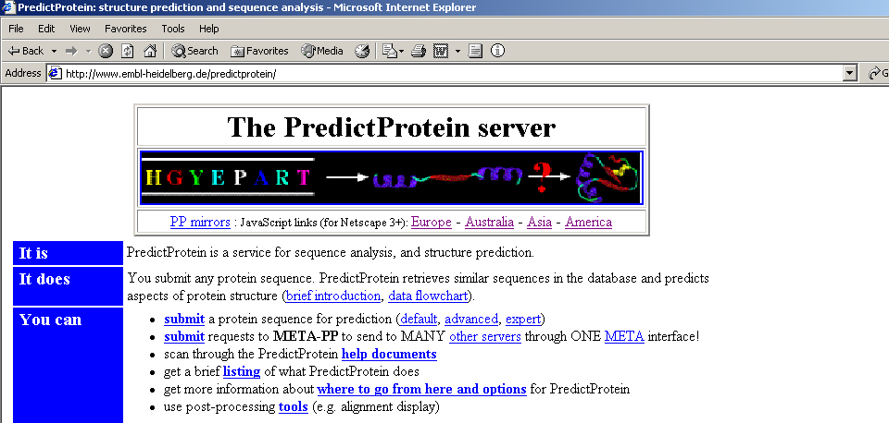
Predict protein problem

Slide 10
References:
1. Berry, M., and Linoff, G., “Data Mining Techniques for Marketing, Sales, and Customer Support”, John Wiley & Sons, 1997.
2. Callan, R., “The Essence of Neural Networks”, Prentice Hall Europe, 1998
3. Harvey, R., “Neural Network Principles”, Prentice Hall International Edition, 1994.
4. Chantratit, V., Lulitanont, V., “Bioinformatics”, NSTDA, Thailand, 2001.
Fausett, L, “Fundamentals of Neural Networks: Architectures, Algorithms, and Applications”, Prentice Hall International Editions, 1994.

